Slide 1

Do you trust your data?
The analysis of 3 data sources for Covid-19

Slide 2
Why did we choose Covid-19 data?
With Covid-19 being such a prevalent matter in modern times, it provides a subject of interest for everyone. Everything in the news is data driven, and because of this, there is a wealth of data. We question whether the data being discussed is fact or fiction. In addition, we know that different states have handled the response to Covid-19 differently and that the population being tested is also different.
Ideally, we would want to look at all the U.S. states to give more validity to our conclusions. We narrowed our scope to six states as a reasonable sample size for the time frame of this project. We also wanted to consider states that differ in Covid-19 time frames as well as policies.

Slide 3
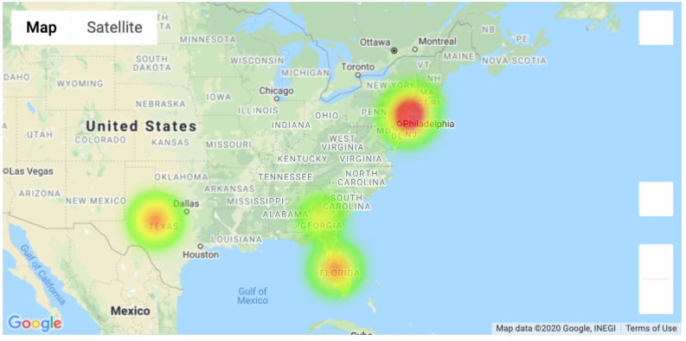
Data comparison for 6 U.S. states using three different datasets
States In Question
New York
Connecticut
New Jersey
Georgia
Texas
Florida

Slide 4

Why did we pick these specific states?
We chose three states from two separate regions of the country that handled the Covid-19 quarantine differently. In doing so we will be able to look at the data from three separate source to find if they correlate as well as the outcomes of the different policies.

Slide 5
Initial Question For Analysis
How do the 3 datasets compare? Are there any consistencies in data? Is there any bias in the data sources?
Hypothesis #1
In comparison of three separate data sources on Covid-19 data, inconsistencies will be apparent in the overall Covid-19 count in each of the six states

Slide 6


Slide 7
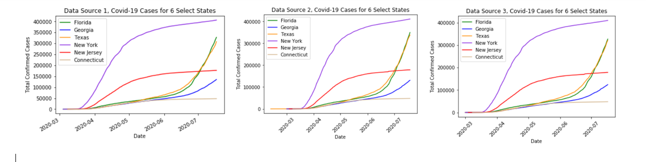
How do the 3 datasets compare? Are there any consistencies in data? Is there any bias in the data sources?

Slide 8
Question 1Conclusion
We can conclude, based on the data, that there is a direct correlation in the data from three separate sources. With such a strong correlations we can reject the hypothesis that there will be inconsistencies in the three data sets.

Slide 9
Question For Analysis
What % of population is tested? How much does testing vary from state to state?
Hypothesis #2
In states where there is a lower percentage of the population being tested, there is a higher
Covid-19 count.

Slide 10
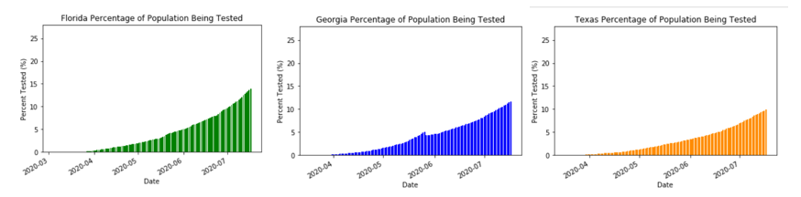
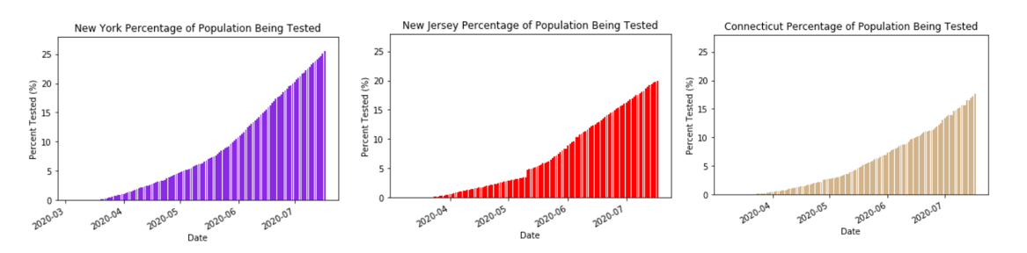
What percentage of population is tested? How much does testing vary from state to state?

Slide 11
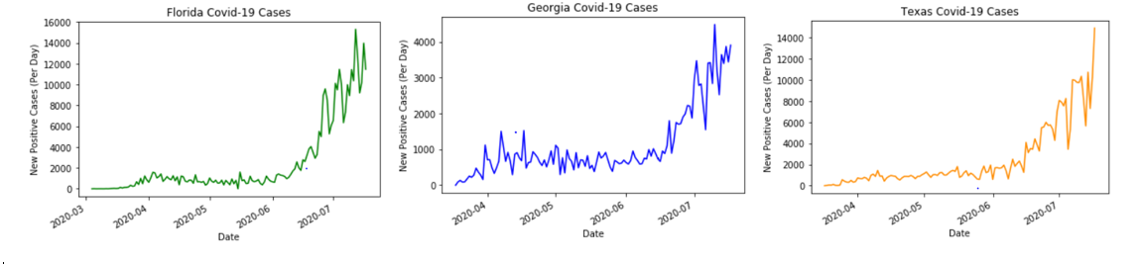
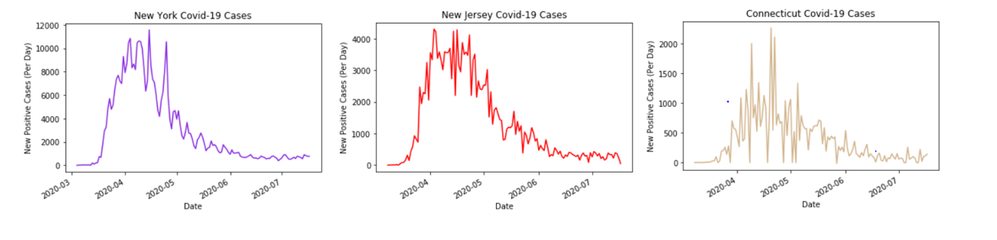
Positive Cases

Slide 12
Question 2 Conclusion
In conclusion, we find that the higher the percentage of the population being tested reduces the increase of positive cases over time as in the case of New York, New Jersey, and Connecticut.

Slide 13
Question For Analysis
Was there any impact from the state shutdown and reopening timing on these six states?
Hypothesis #3
Not reopening will reduce the amount of positive Covid-19 cases.

Slide 14
References
https://covidtracking.com/data/download
https://www.kaggle.com/fireballbyedimyrnmom/us-counties-covid-19-dataset?select=us-counties.csv
https://raw.githubusercontent.com/nytimes/covid-19-data/master/us-states.csv
https://www.kaggle.com/headsortails/covid19-us-county-jhu-data-demographics/data?select=us_county.csv
https://www.washingtonpost.com/graphics/2020/national/states-reopening-coronavirus-map/
https://www.cdc.gov/covid-data-tracker/#cases

